Slide 1

CST4070 Applied Data Analytics
Student
Name: Neet
Surname: Madan
Student ID: M00846242
Campus: London
Group number:1
Note. This front-page will not be included in the total page count.

Slide 2
Problem definition
Talk here about:
The problem that you are going to address.
Experienced the first case of Covid-19 outside of China in Jan 2020, Thailand’s strict government lockdown restrictions kept Covid-19 cases under control. However, though Thai government had put into effect the second Lockdown restriction during April 2021 to July 2021, Thailand’s still faced peak of Covid-19 cases that grew exponentially.
Furthermore, Thailand had faced a delayed in retrieving vaccinations compared to the rest of the world and had vaccinations administered, and had highest vaccinations administered during the peak deaths from Covid-19. This research also seeks to study whether there was an overturn in mobility and if confidence was returned to users to be more mobile after the vaccination program had been rolled out.
The aims and objectives of the project.
Aims: To investigate the difference in Covid-19 and mobility from two time periods April 2020 to July 2020 in comparison with April 2021 to July 2021 which are Lockdown 1 and Lockdown 2 in Thailand respectively
To investigate the relationship between new cases, new deaths and new vaccinations with mobility during April 2021 to December 2021 where several key Covid-19 events took place consecutively in Thailand. As they experience exponential growth in cases, deaths and had peak vaccinations administered consecutively during this time period.
Objectives:
Datasets used were Google Mobility and OurInWorldData (OWID)
Datasets were cleaned and synthesized to study the relationship between the variables.
Datasets were filtered, and consolidated into Monthly and Weekly aggregated levels for different types of tests.
The contribution of the project.
This research aims to contribute to Thailand’s covid and infectious disease literature by providing insights into whether there was a decrease in the effectiveness of government lockdown measures and whether the vaccination administered could return mobility to normality right after the highest number of deaths.
Highlight the main steps required to complete your group project
Proposal : Data exploration was done to check several countries and we concluded in Thailand. As there were several key events that took place in Thailand, we reviewed the trend of Covid-19 cases, mobility and other measures to see which trends stood out and matched with the events read in the newspapers and journal articles. Research papers were searched in previous countries and consolidated to find the best statistical method to prove our research questions. Hence, we conclude our research questions. A proposal was written.
Final Research Paper: Data was cleaned, joined and consolidated. We reviewed the research questions and eliminated out research questions to see which ones we could not implement. Theories on statistical methods were searched. Coding and data exploration was done and discussed. We reached a conclusion on our results and a paper was written.

Slide 3
Division of labour
Explain here how the main steps introduced in the previous slide have been broken down among the members of your group.
Data was filtered for period and country required, consolidated and joined between Google Mobility and Covid-19 dataset. Neet & Vaibhav
Coding of dataset cleaned, finalized, and consolidated - Neet
One member researched several quotes and sent a file if we needed anything from any theory. - Tega
Data was then split between two members to work on different aspects, 1 member worked on data exploration, Anova and writing results of the entire paper. -Neet
The other member worked on the causality test. –Vaibhav
Discussions between two group members – Neet and Vaibhav
Entire report was written and finalized - Neet
Briefly introduce your individual contribution.
My individual contribution involved cleaning the data, finalizing the code, reviewing the coding sent by my team member (Vaibhav), any theories on time lag that could help us from Tega and reviewing the results and writing the entire research paper.

Slide 4
Individual contribution
Use this slide to say more words about your individual contribution.
Introduce the steps you performed in great detail.
I introduced the file and current research proposal in Teams with comments and ensured anyone to cooperate and work on the file and read if they had any questions.
I asked to set up calls for division of labor consistently to start working on the project.
Met on the university campus for one meeting to discuss on the division of labor and worked on the data cleaning for the start of the project to ensure we can divide the work and work on it amongst the entire group.
Standardized the data and did the data exploration, to ensure that the trends within the dataset matched our current literature review and tune the literature review to the final research questions we agreed to change.
Worked on the dataset and discussed with another group member (Vaibhav) throughout, and once coding was finalized on his part for the second part of the statistical test, I wrote the research paper.
Highlight the steps which one worked well and the ones which did not.
The dataset was checked for stationarity, and it was not and we had very less time left as a lot of time. Due to the time limitation, we dropped Todayamato causality test and concluded on using Pearson correlation to see the statistical relationship for second and third research questions. The result of Todayamato also did not align with Pearson correlation. The results of Pearson correlation matched with the trends we suspected and it worked well with creating a story for our research.
Introduce the main challenges you faced and the solution you adopted to solve them.
The main challenges were doing the Todayamamoto test, in the end we had to eliminate it and focus on using Pearsson correlation as due to the time limitation we no longer had time to work on this and change our entire conclusion.
Stress here why your contribution was important for the rest of the team to complete your group project.
Generated the final idea to pick Thailand a case study, went through the data exploration stage meticulously to study the trends on what we read on the news and the current situation in Thailand matched with the peak covid-19 cases in Thailand. Advised the group on statistical tests and formulated research questions that we can implement for the research. Discussed with another group member and finalized the research questions to be tested, was critical and involved in all part of the process included, Idea formulation, research question formulation, discussion, data exploration, coding for statistical test, discussion on causality test to help team member and was key in writing the research paper.

Slide 5
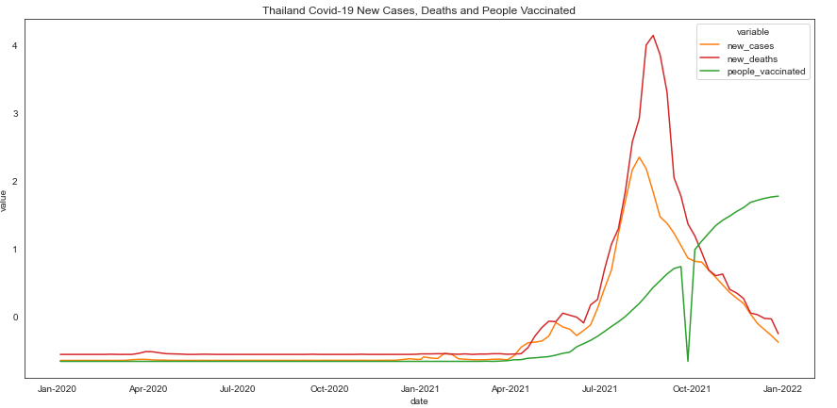
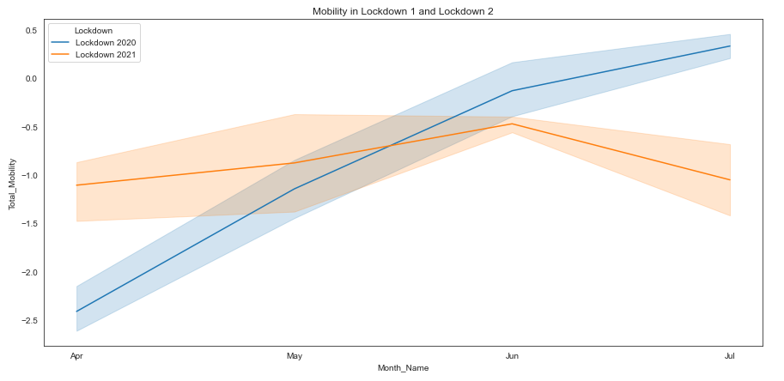
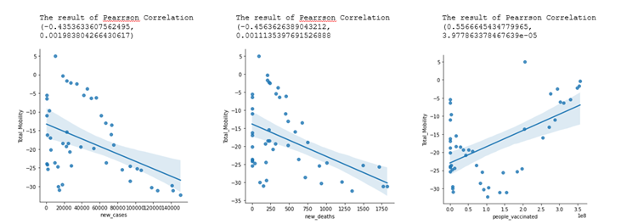
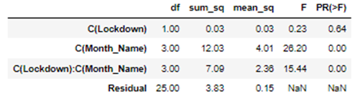
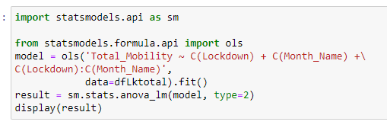
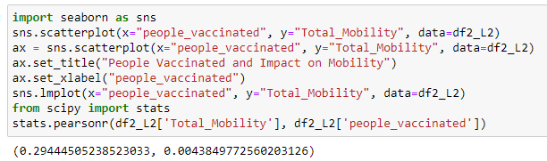
Technical samples
Attach here some details of the most relevant steps you performed.
Data Visualizations were used to do the data exploration to show preliminary Covid-19 and mobility events that were consistent with the literature review. Further data exploration was also done to show the difference in mobility level for two time periods comparing the same months in two years. Furthermore, data exploration was done to show the scatterplot relationship for Mobility and new cases (weekly aggregated), Mobility and new deaths and Mobility and Vaccinations.
Statistical Test Two Way Anova to show there was a significant difference in variance in Mobility when Months and Lockdown interacted as a categorical variable in two time periods, showed mobility was different in two lockdowns. It could be that the government restriction did not restrict mobility very highly as shown in the graph during the start of the lockdown as compared to the first time.

Slide 6

Technical samples
3. Research Paper:
Also wrote the research paper and finalized all discussions and details with other group members.

Slide 7
Critical reflection
Conclude your presentation by summing up the high-level steps you personally adopted to help your team members to complete your project.
I shared the project online, create a team group to ensure collaboration amongst team members and set up online calls to lead the project through.
Always ready to help a team member catch up on details they have missed, to ensure they can continue the discussion and not miss out on anything. Worked collaboratively, understanding and followed up with any work that needs to be added to the final work.
Tried my best to make it easy for any group member to get involved, by not pressurizing and asking for meetings online to see if anyone wanted to contribute and how they could contribute
In the end, accept the contribution of the team members as is, without taking too much time to focus on that and focus on ensuring the work gets completed to meet the deadlines.
Highlight the lesson learned.
To take a step back and be a follower, to ensure equal responsibility and enthusiasm from all group members to complete the work. To not show high level of responsibility but an adequate level so group members feel the need to step up and help.
What did you learn during this project?
I improved my skills in python, data exploration, research question formulation and increased my efficiency in python coding. Personally, I wanted to use R as it was more familiar and easier, however, as a group member liked Python more, I got a chance to learn and enjoy python.
What challenges did you encounter? What kind of skills have you learned to solve them?
Due to limited time and resource capacity, we maximized our time and worked on it the best that we could, I learned that sometimes we may not get the best results, but we put our best foot forward anyway to ensure we achieve it. For the first time, I am not working for a distinction, I learned that it is completely fine to not get a perfect score, I am working to ensure I learn something and meet the deadline.
What mistakes did you make? What would you do different in your next project to avoid them?
Becoming a better communicator, more diplomatic, work-focused, passive, very agreeable and be more conditional in showing responsibility.

Slide 8
Peer evaluation
Replace the toy IDs/names with your group details. Order by student ID (ascending order). Include yourself in the list.
Student ID | Student name/surname | Mark | Reason of the mark given
M00846242 | Neet Madan | 4 | Participation in developing ideas Tried extremely hard to engage the group Interest and enthusiasm in the group project Ease and familiarity with the discussion material Needs to be more diplomatic and calculating in actions to ensure group members at least help.
M070 | Vaibhav | 4 | Participation in developing ideas Willingness to discuss the ideas of others Ease and familiarity with the discussion material
M00742842 | Ajeet Mishra | 3 | Participation in developing ideas Contributed during research proposal stage
M00860651 | Renas Nasser | 1 | Contribution to writing an explanation of where the dataset came from during the research proposal stage. No contribution during this research paper.
M345 | Tega | 3 | Participation in developing ideas Willingness to discuss the ideas of others Cooperation with other group members
Assess your work and the one from your group members.
List your team members (including yourself!) and assess each of them (including you!) according to the following criteria:
Participation in developing ideas
Willingness to discuss the ideas of others
Cooperation with other group members
Interest and enthusiasm in the group project
Ease and familiarity with the discussion material
You can give the following scores:
5 = Excellent work; was crucial component to group's success
4 = Very strong work; contributed significantly to group
3 = Sufficient effort; contributed adequately to group
2 = Insufficient effort; met minimal standards of group
1 = Little or weak effort; was detrimental to group
For each score, briefly motivate it.
Remember to peer-evaluate every member of your team, including yourself!

